Slide 1
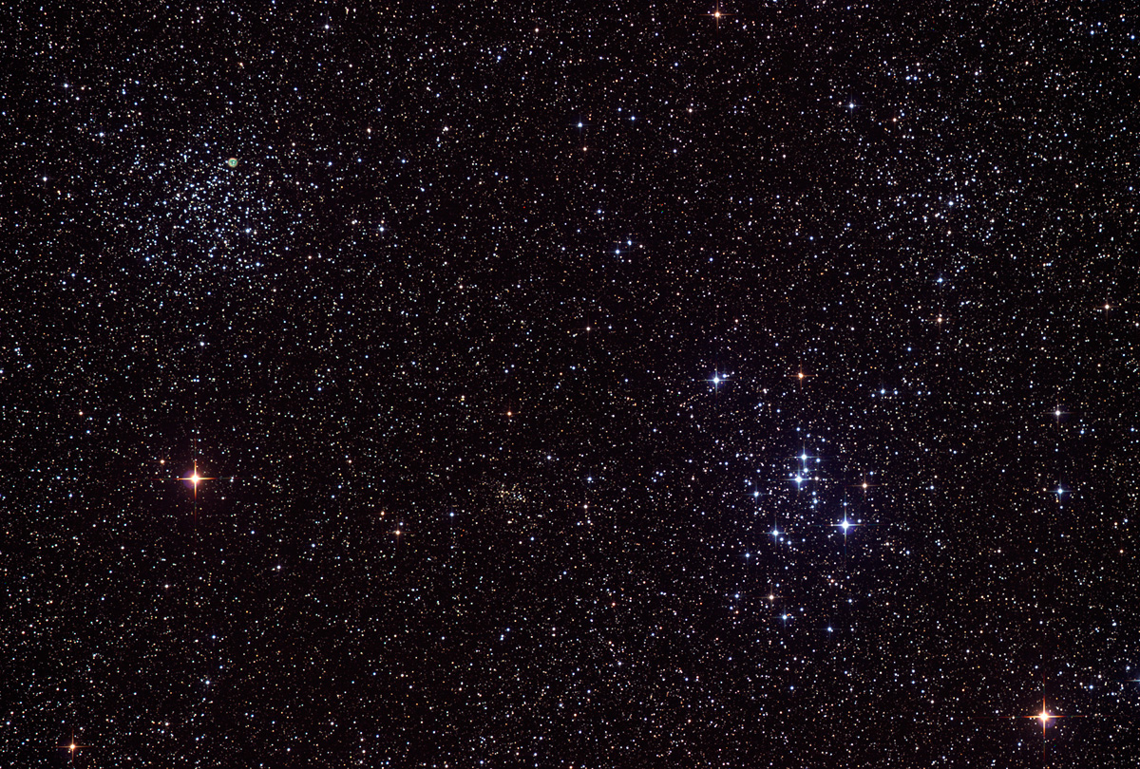

Howard
Astronomical
League
14
March 20th, 2014

Slide 2
Introductions

Slide 3
Upcoming club activities

Slide 4
Star Parties and public outreach!
March 22nd: Public Star Party
March 29th: Members-only Star Party (Messier Marathon)
April 5th: Public Star Party
April 5th: Scope out the night, 6:30-9:30 pm, RNC
April 5th: Greenfest, 10 am-4 pm, HCC

Slide 5
Proposed change to by-laws

Slide 6
Article II, section 2
Current wording:
The Corporation shall admit persons to membership at any time. Application for membership is via a written form or via HAL website on-line form. The membership year shall begin on the date dues are paid, and end at the end of the month, one calendar year later.
Proposed wording:
The Corporation shall admit persons to membership at any time. Application for new membership or renewal is via the HAL website on-line form or via a written form submitted directly to the Treasurer, or mailed to the HAL address listed on the website. The membership year shall begin on the date dues are paid, and end on the same date the number of calendar years later specified by the selected membership term.

Slide 7
Observatory update

Slide 8
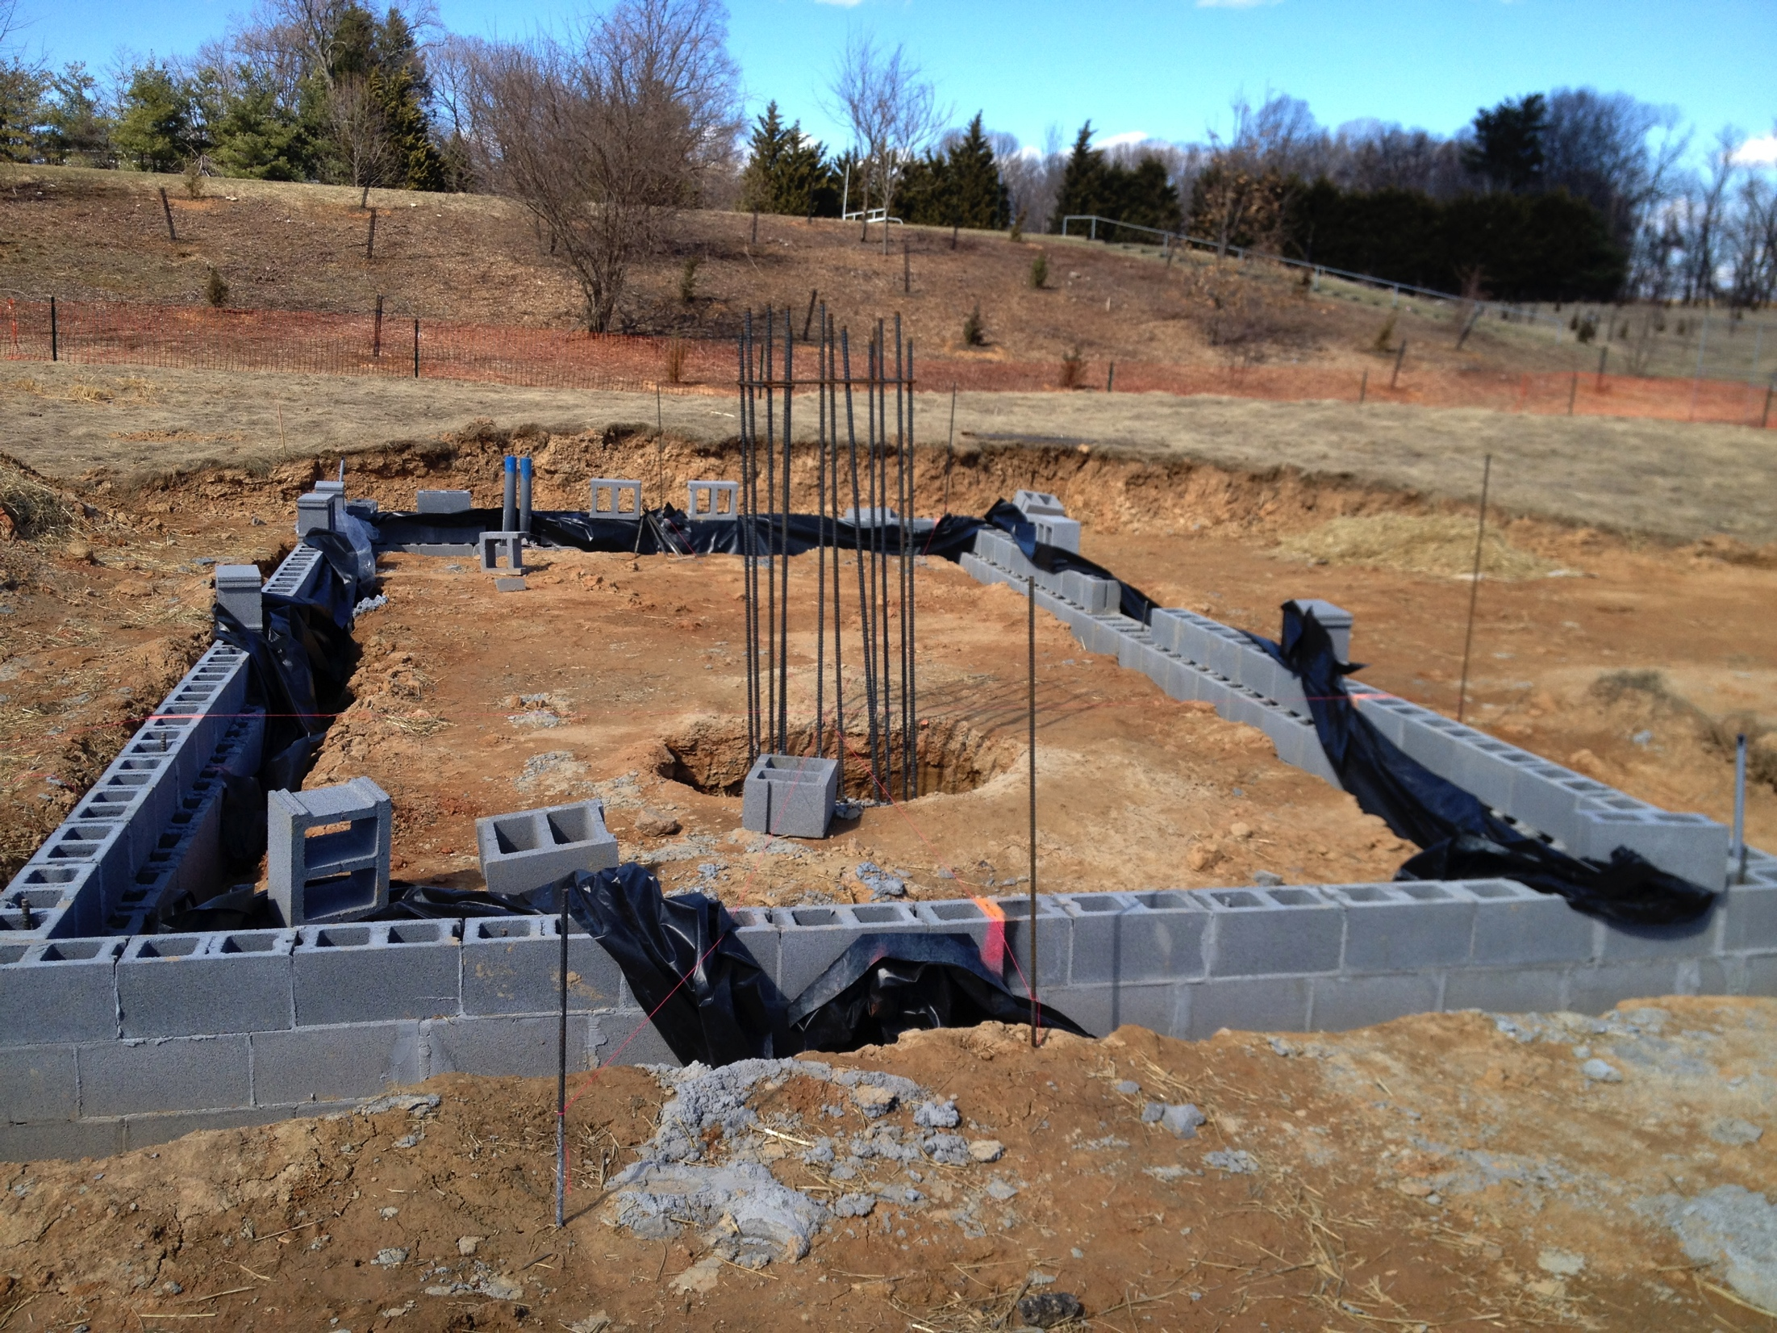
Observatory update
Notes:
The foundation of our observatory!

Slide 9
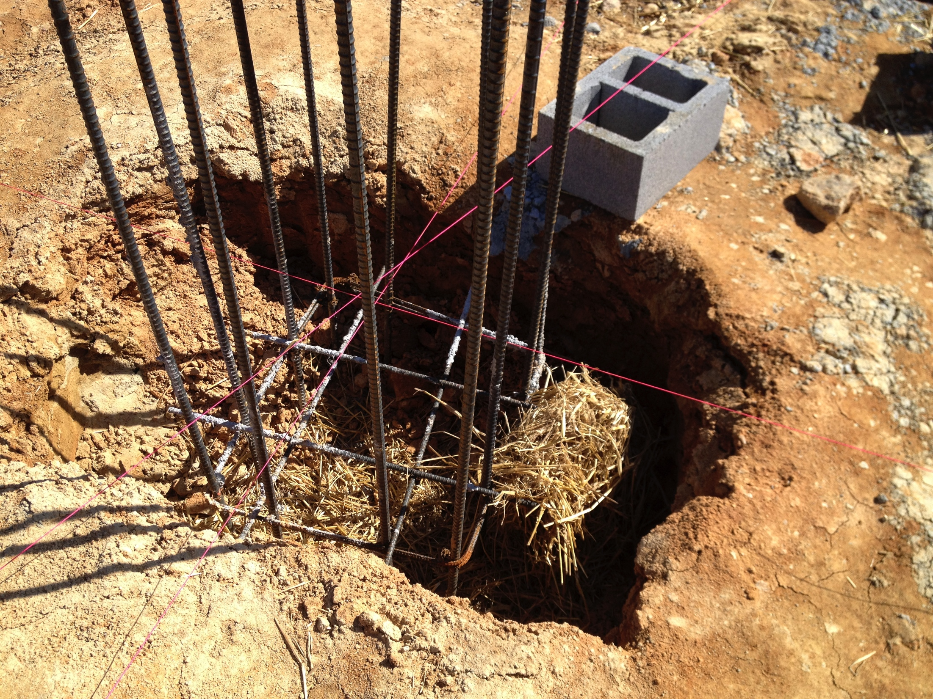
Observatory update

Slide 10
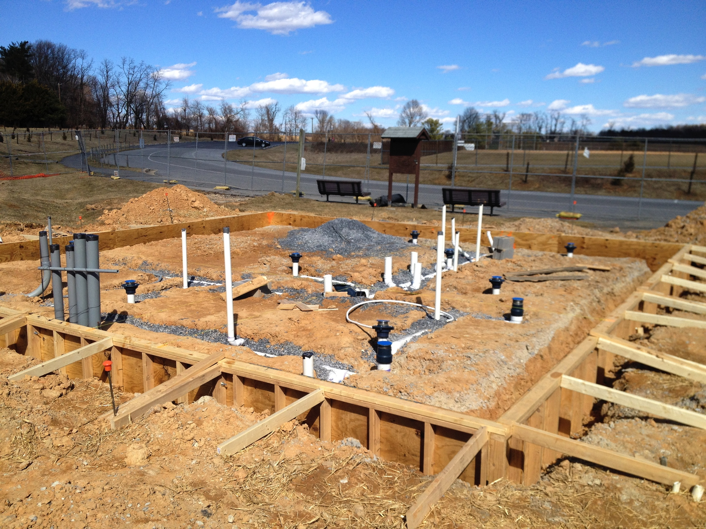
Observatory update
Notes:
The restroom facility.

Slide 11
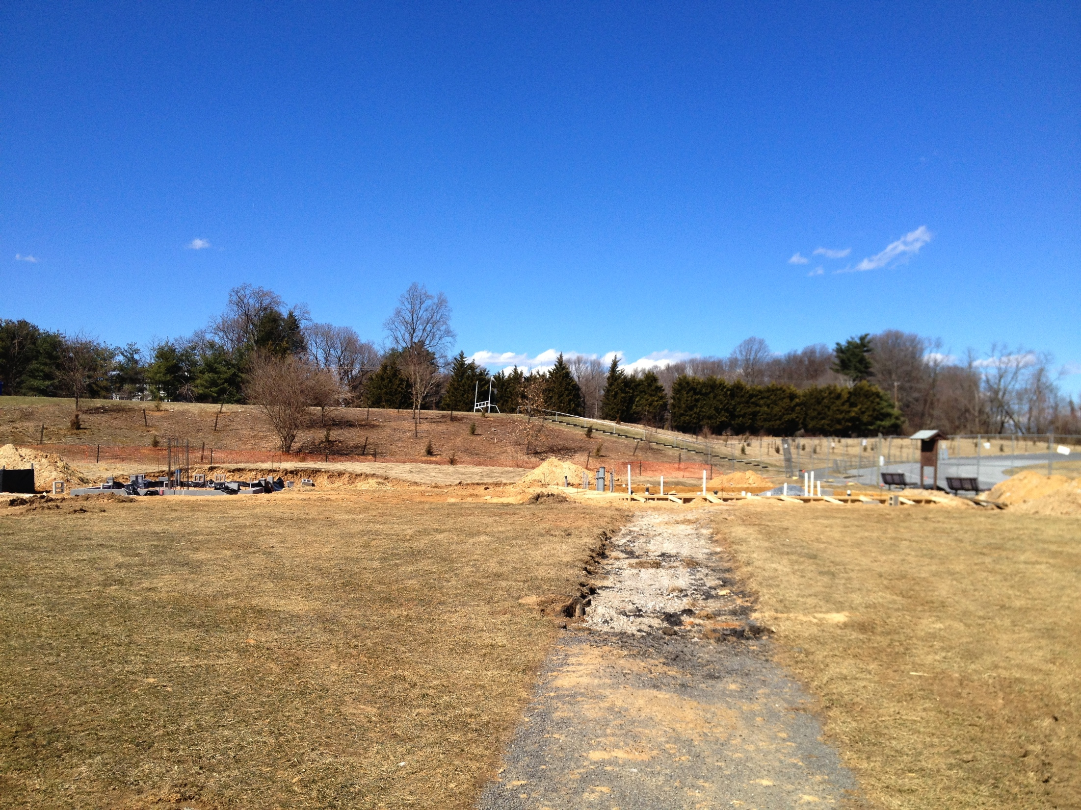
Observatory update
Notes:
The restroom facility.

Slide 12
Member’s astrophotos and sketches

Slide 13
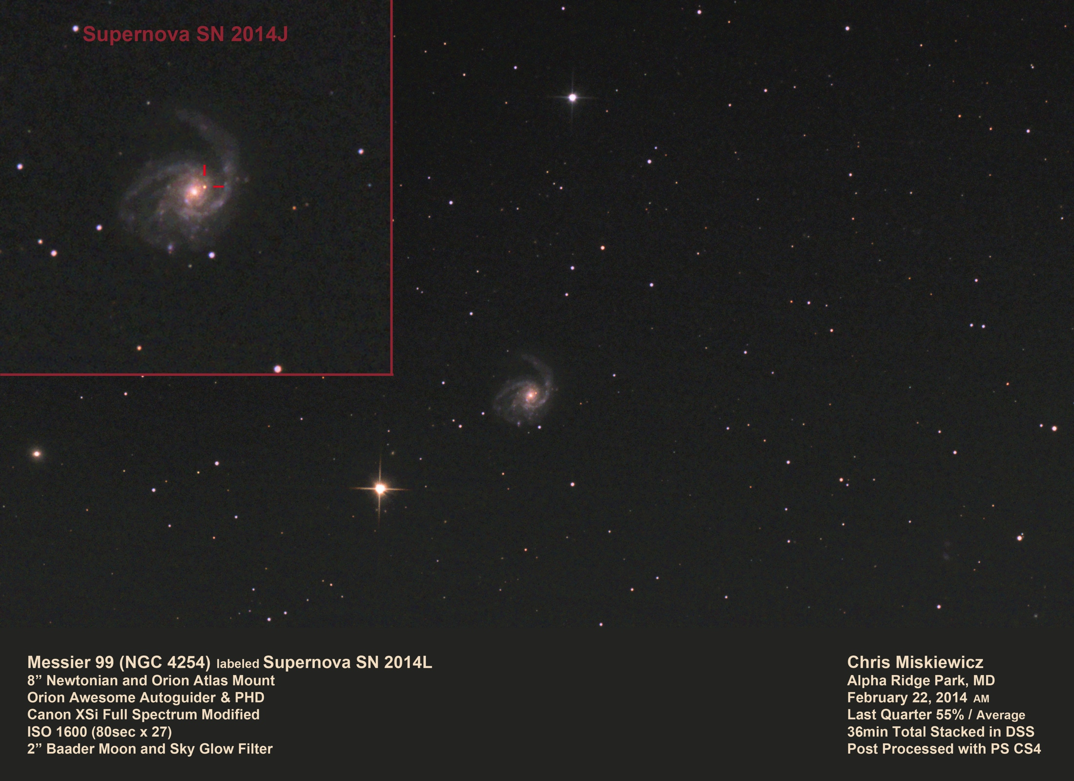
Chris Miskiewicz

Slide 14
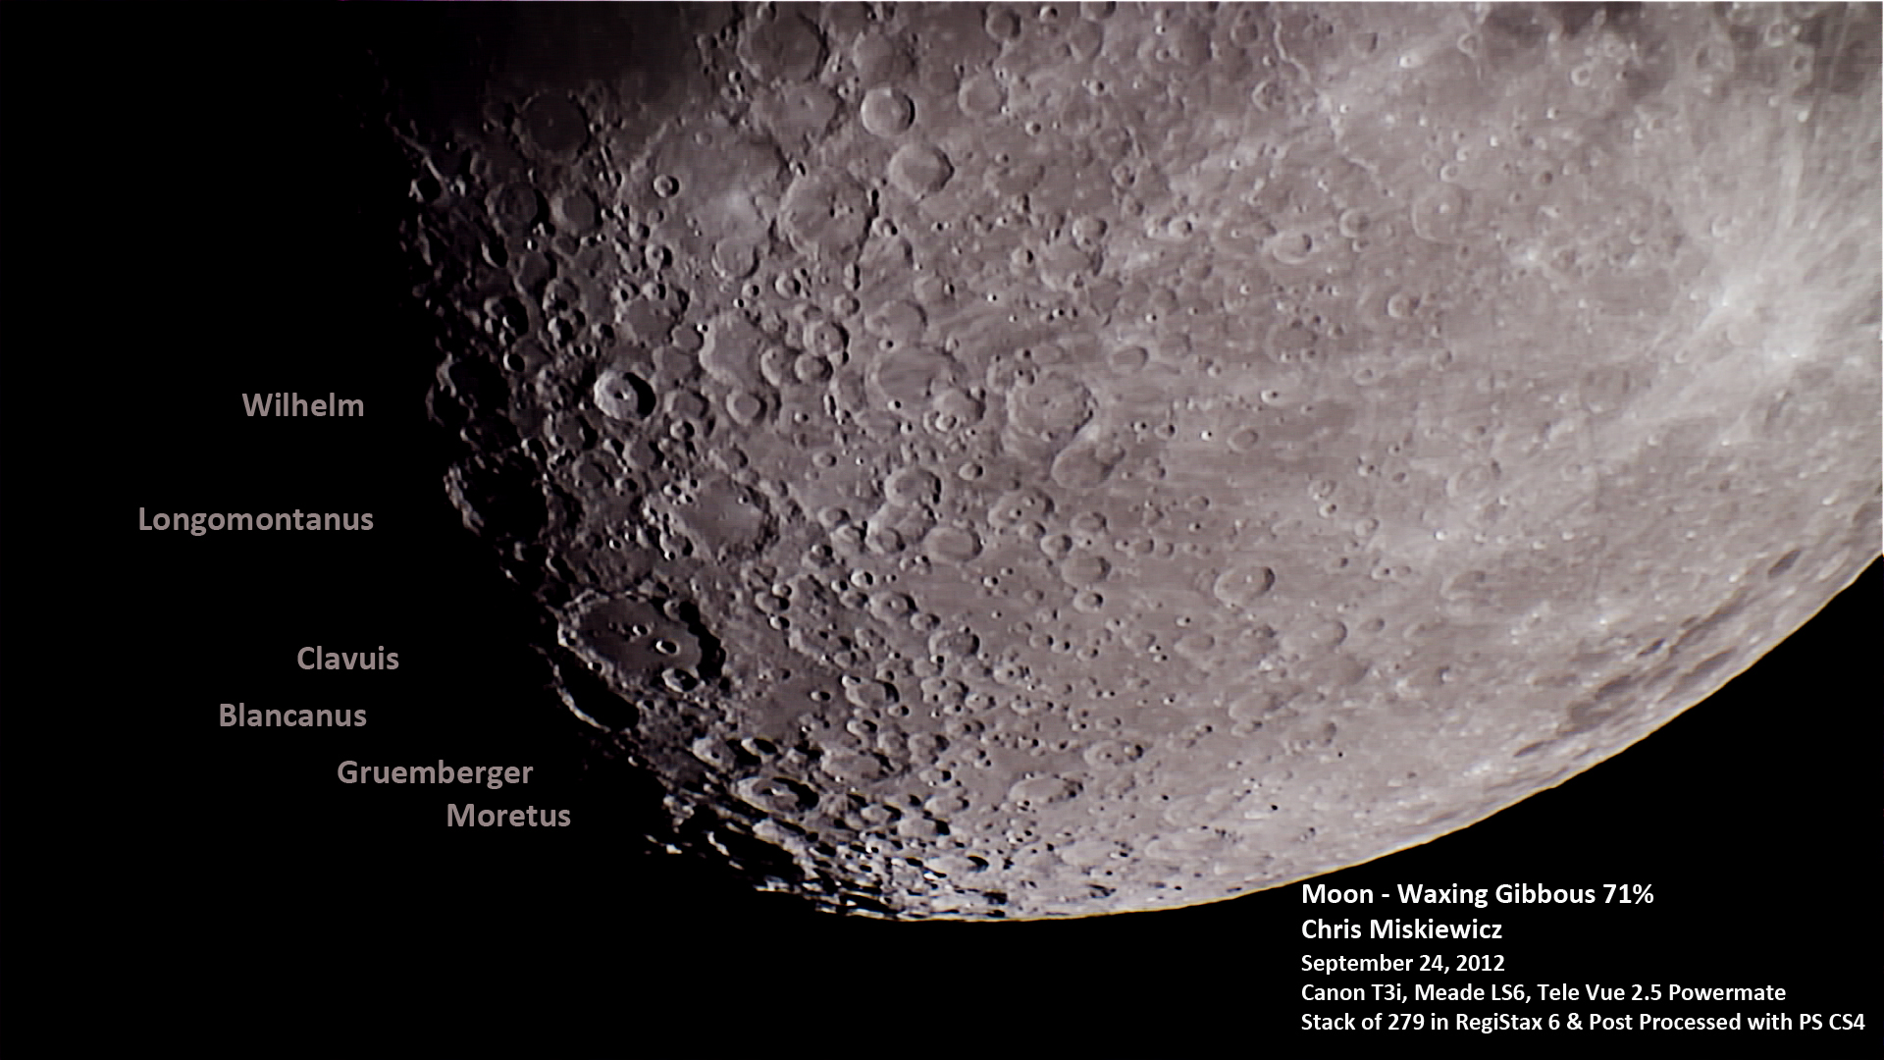
Chris Miskiewicz

Slide 15
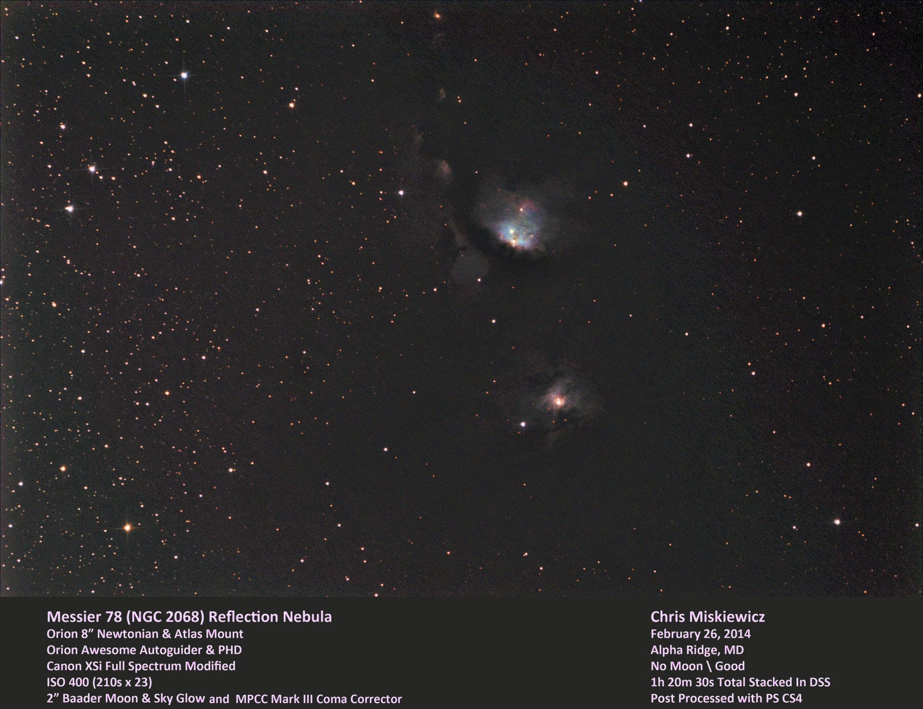
Chris Miskiewicz

Slide 16
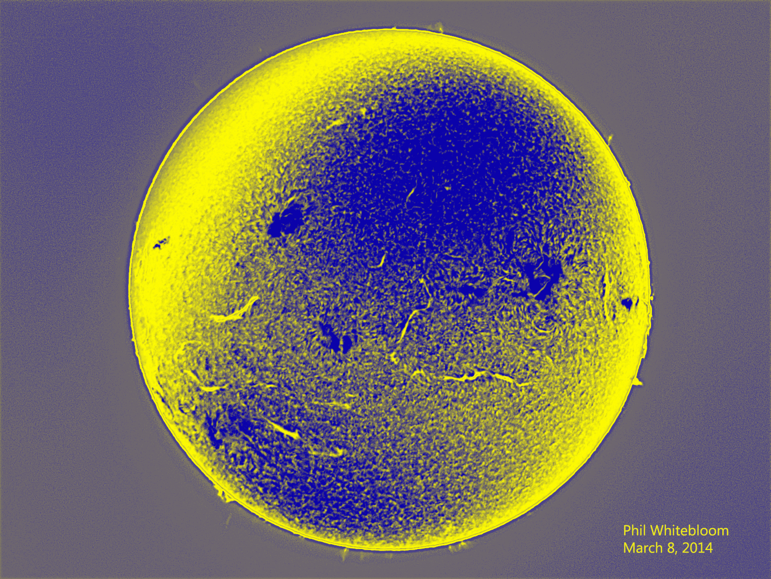
Phil Whitebloom

Slide 17
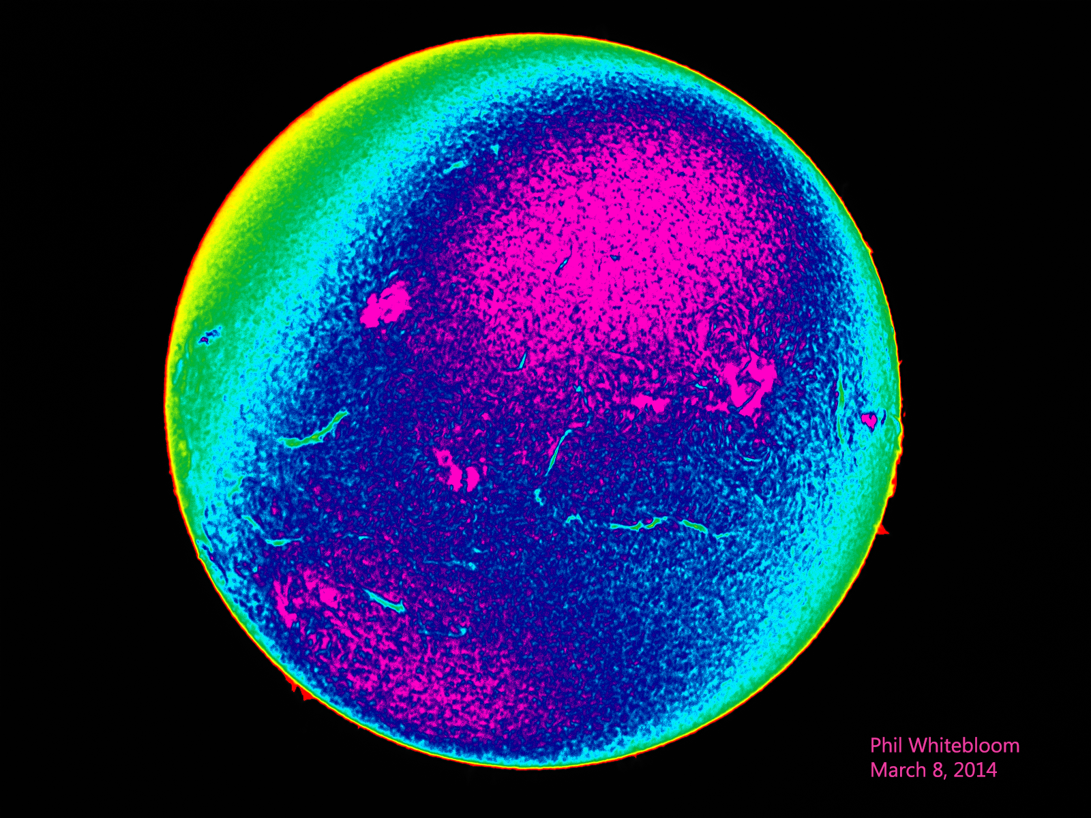
Phil Whitebloom

Slide 18
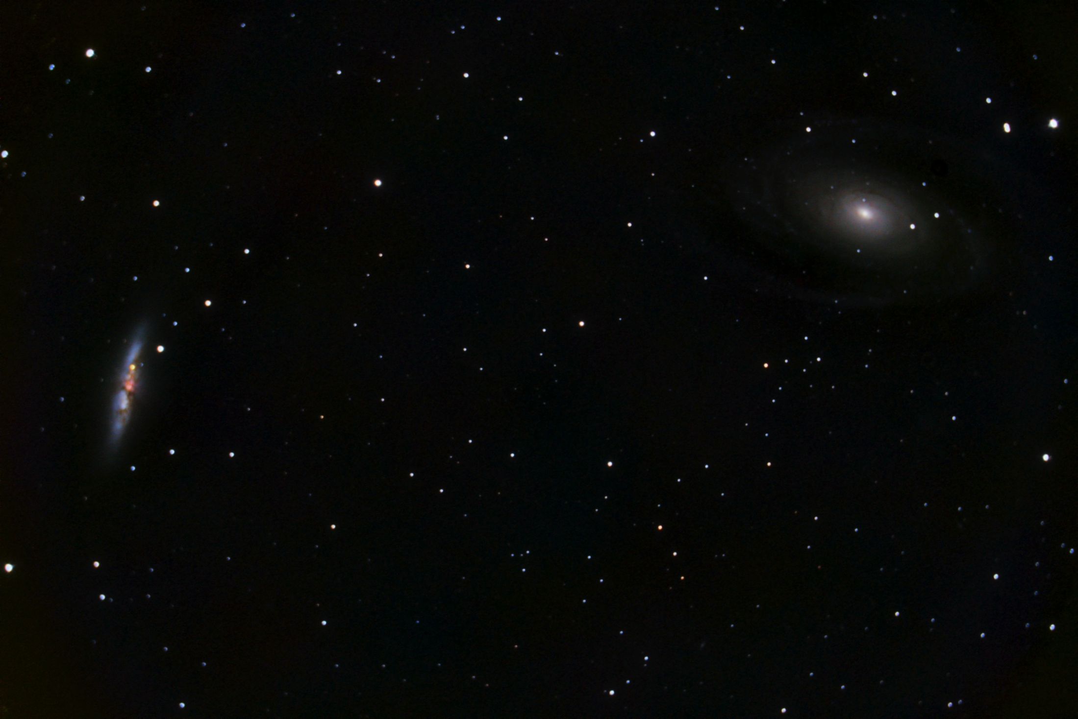
Victor Sanchez

Slide 19
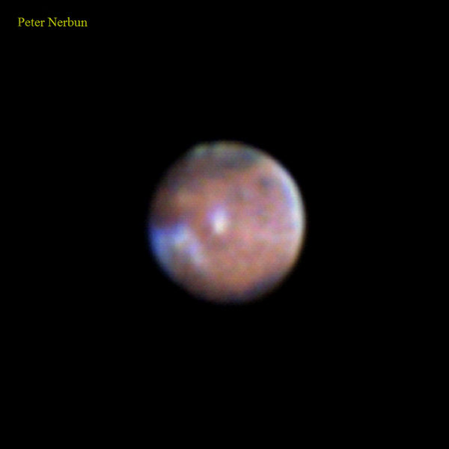

Slide 20
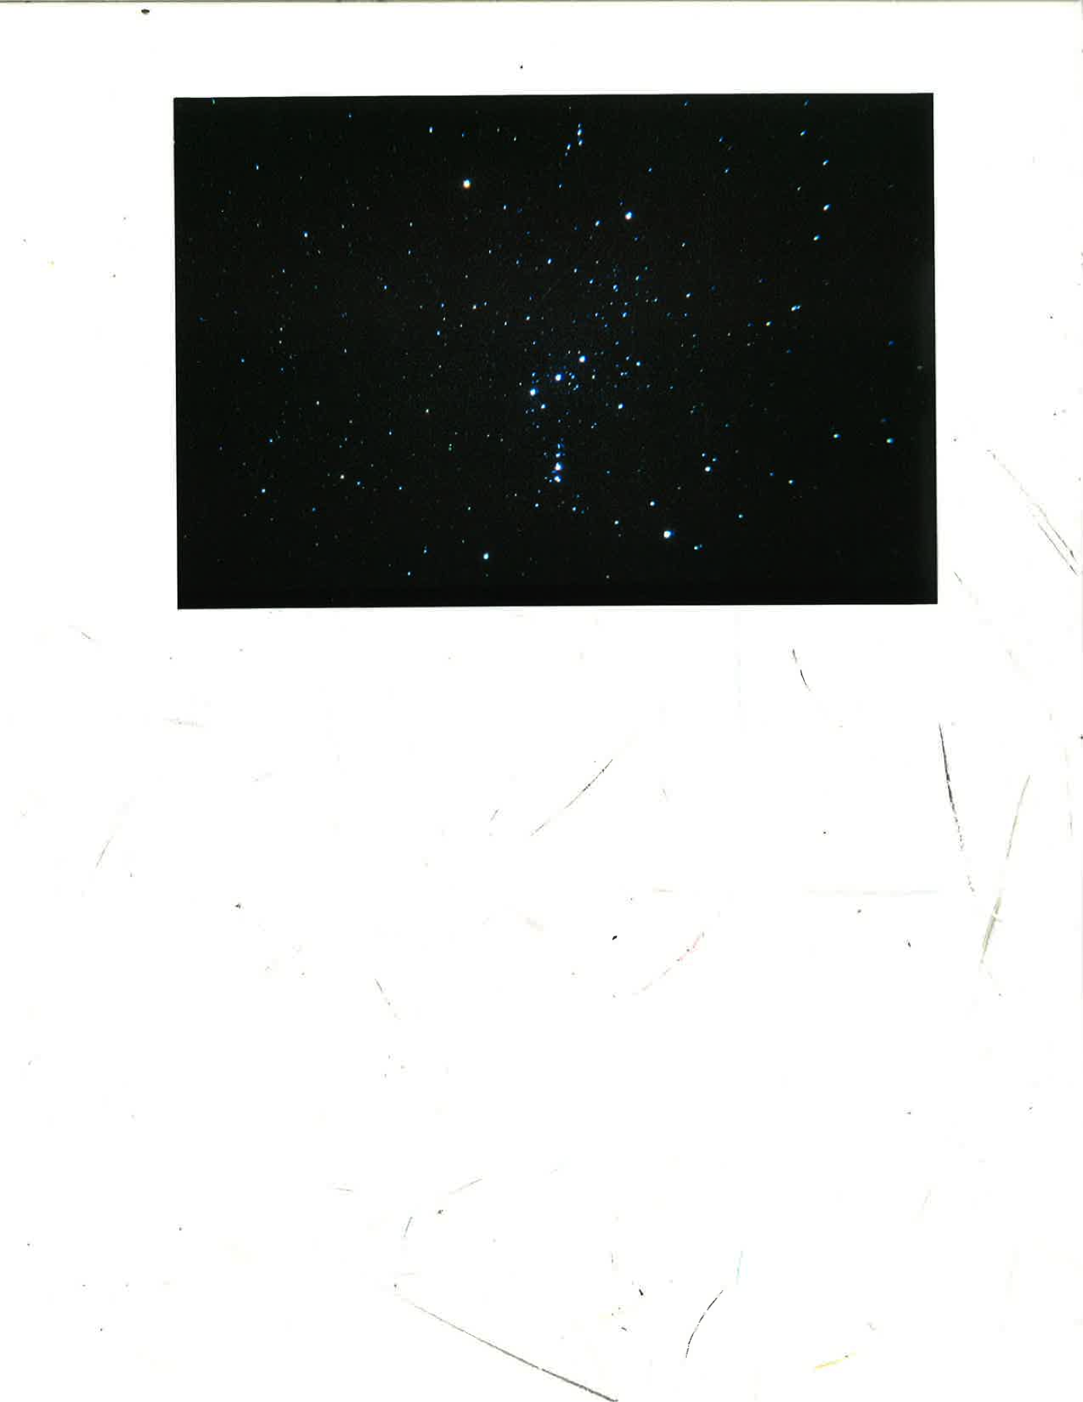
Herman Heyn
Notes:
17-sec., ISO 400, 50mm, f/1.7.
Shows approximately a naked eye view under a perfect sky.

Slide 21
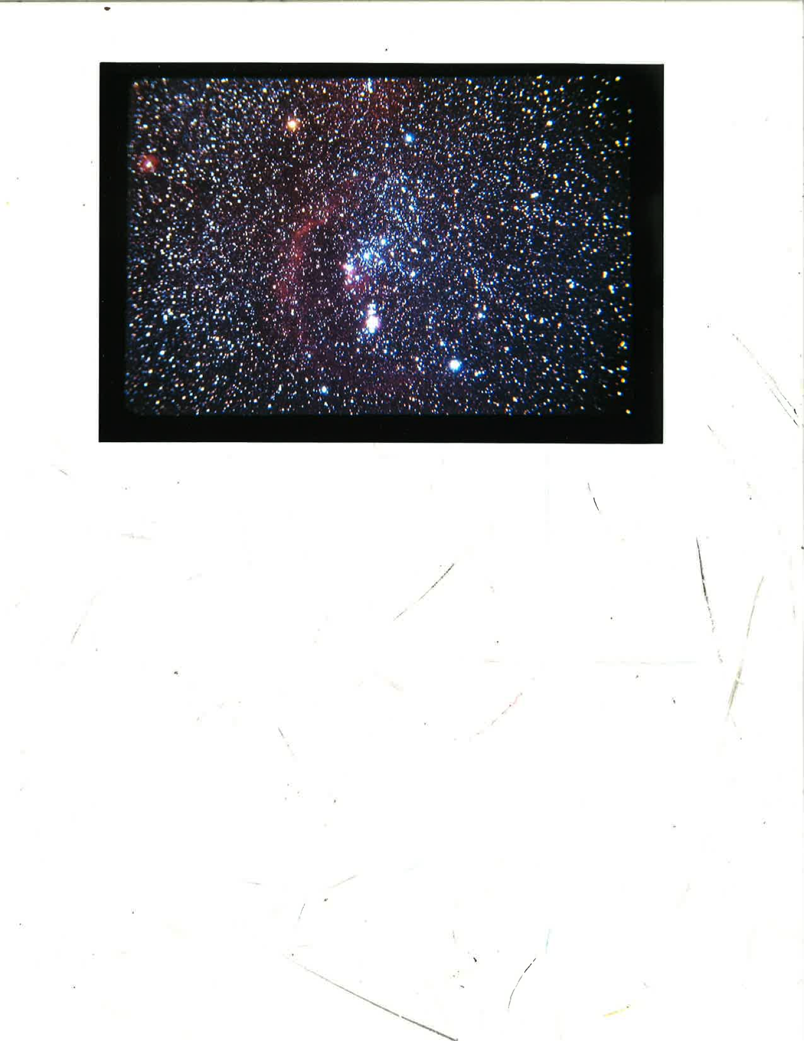
John Sanford, shared by Herman Heyn
Notes:
A 30-min. guided exposure taken 1990 by the late,
great astrophotographer, John Sanford, of the Orange County, Calif.
Astronomy Club. 50mm lens. Shows same area and scale as my photo,
but also shows what's really up there!

Slide 22
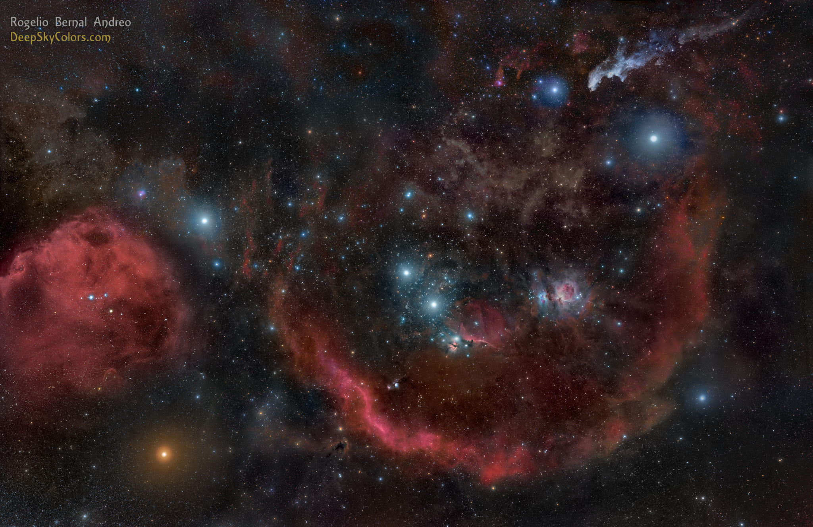
This is what’s really up there! 20 years of technology gets you this.
Notes:
Roughly the same field of view, but this time it REALLY shows what’s up there. This was taken in 2010, twenty years after the last photo.

Slide 23
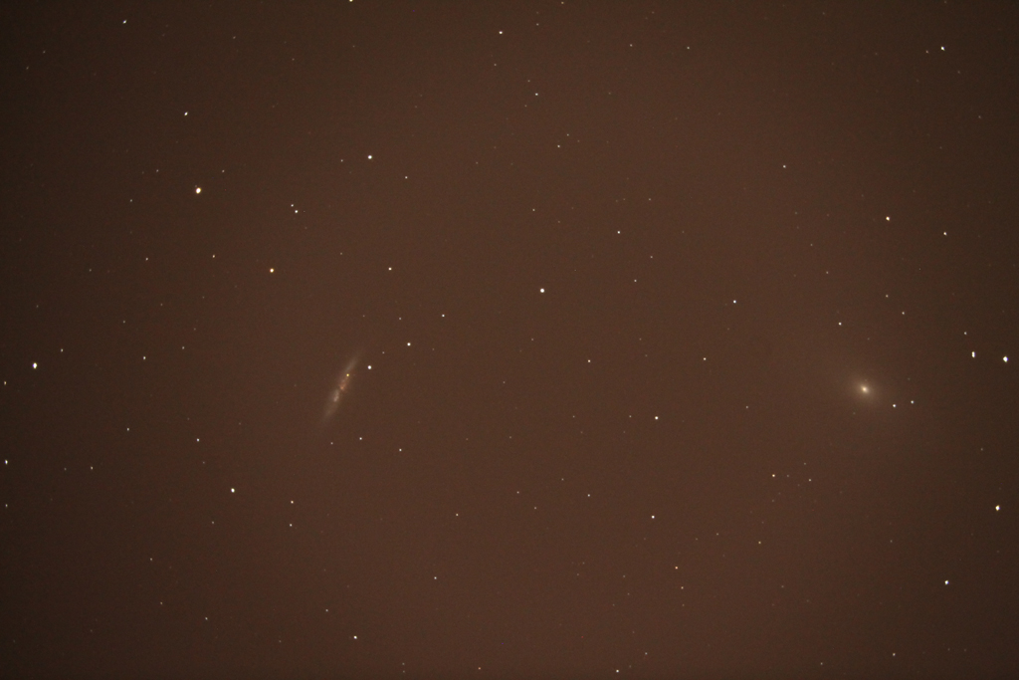
Mike Krauss

Slide 24

Mike Krauss

Slide 25
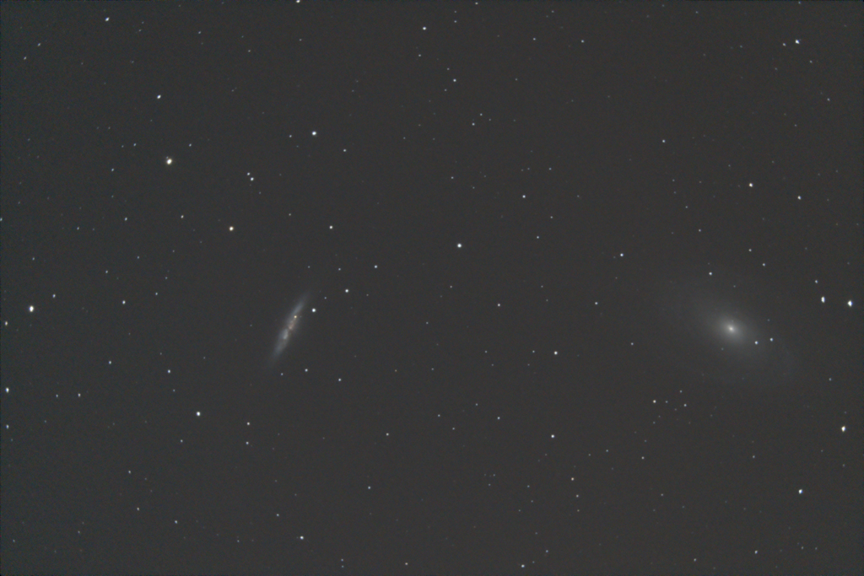
Mike Krauss

Slide 26
Winter Star Party
Joe Bohannon

Slide 27
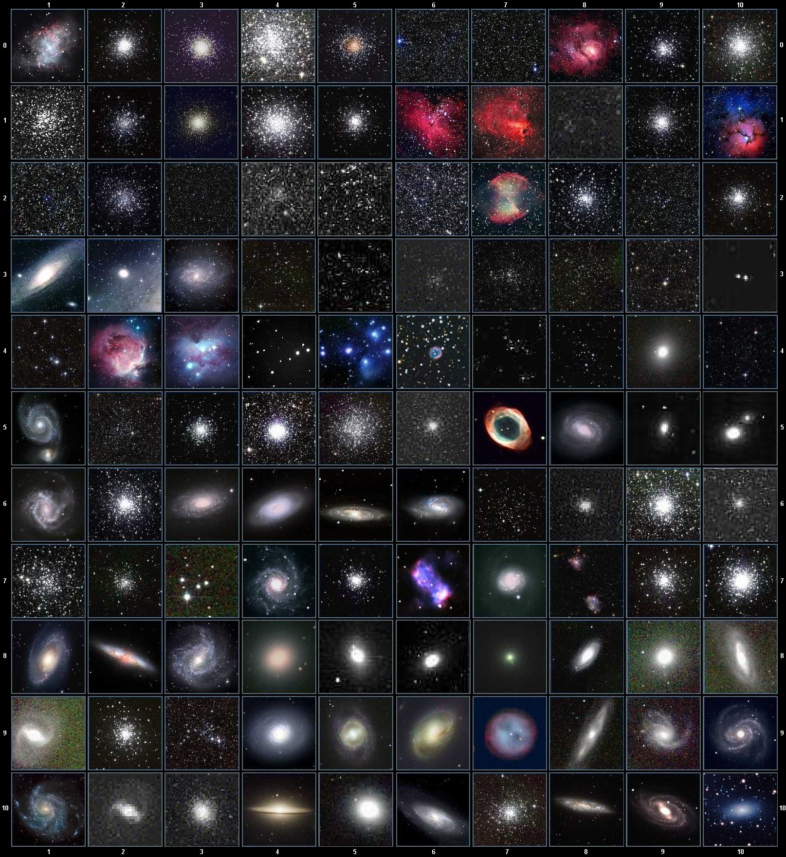
Messier Marathon
Notes:
“An informal competition to locate and observe the most Messier objects by a single observer during a dusk to dawn Marathon”.
The point is to hunt them down yourself, not use digital aids like digital setting circles or Goto scopes. While we will have prizes for the person that finds the most by star hopping, but this is a competition where everybody wins, because you’re going to see a lot of wonderful objects, and spend an all-nighter with your friends.

Slide 28
What is a Messier Marathon?
“An informal competition to locate and observe the most Messier objects by a single observer in a dusk to dawn Marathon.” – Amateur Astronomers of Pittsburgh
Notes:
competition to locate and observe the most Messier objects by a single observer during a dusk to dawn Marathon

Slide 29
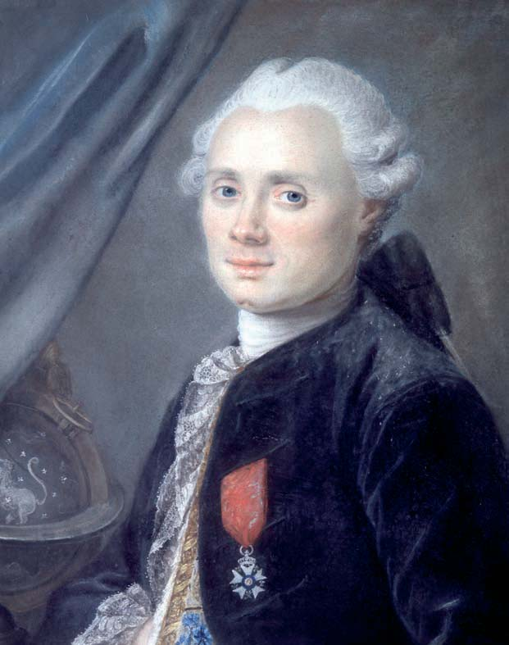
What are the Messier objects?
110 of the brightest and most beautiful objects in the Northern skies.
(That aren’t comets)
Notes:
competition to locate and observe the most Messier objects by a single observer during a dusk to dawn Marathon

Slide 30
Why do a Messier Marathon?
It’s fun!
You’ll see a lot of beautiful objects
Hanging out all night with your buds
Become more familiar with the sky
Become more familiar with your equipment
Become a better observer
Sense of accomplishment

Slide 31
Messier Marathon March 29th
Prizes for HAL members that observe the most Messier objects:
Visually, using star-hopping:
HAL coffee mug
Visually, using GoTo or DSCs:
S&T Pocket Sky Atlas
Sketching: HAL Hoodie
Photographically: Orion eyepiece

Slide 32
Messier Marathon March 29th
Sunset 7:30 pm
Civil twilight ends 7:55 pm
Nautical twilight ends 8:26 pm
Astronomical twilight ends 8:59 pm
Astronomical twilight begins 5:24 am
Nautical twilight begins 5:57 am
Civil twilight begins 6:28 am
Sunrise 6:52 am
Moon rise (1.6%) 6:36 am

Slide 33
Messier Marathon
Hardest objects:
M74 – sets at 9:15 pm, will only be 7* high at beginning of nautical twilight
M77 – set at 9:27 pm, only 9.9* high at beginning of nautical twilight
M30 – rises at 5:41 am, will only reach 8.2* by end of nautical twilight

Slide 34
Messier Marathon
Sort objects by Right Ascension
(Move West to East and South to North)
Southerly objects set first, so observe them first
Anything with Declination > 50* is circumpolar and will be up all night
(11 objects)

Slide 35
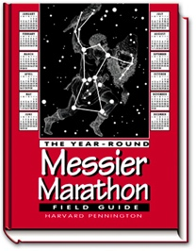
Messier Marathon

Slide 36
Thank You!
Next month’s meeting is on Thursday,
April 17th, 2014 7:30 PM
Meeting Speaker:
Dr. Brian Jackson, “The Exoplanet Revolution”
Astroschool, 7 pm: Star Hopping and Star Charts

